Slide 1
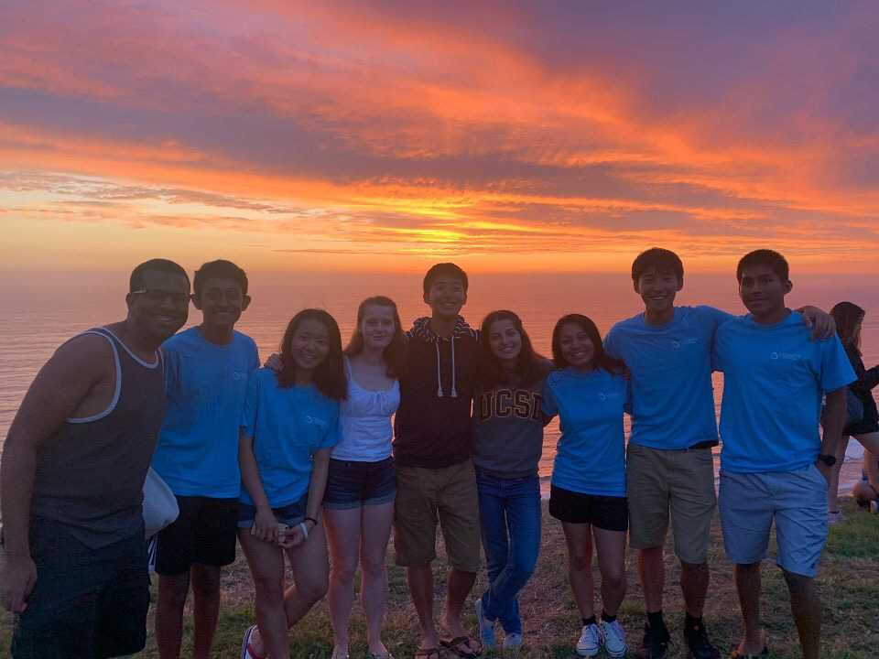
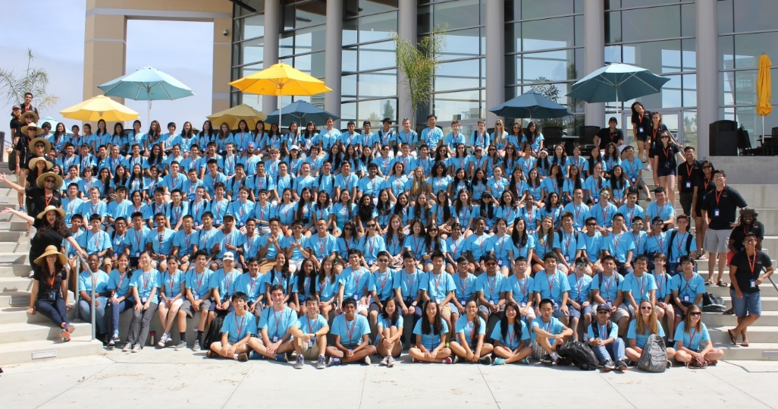
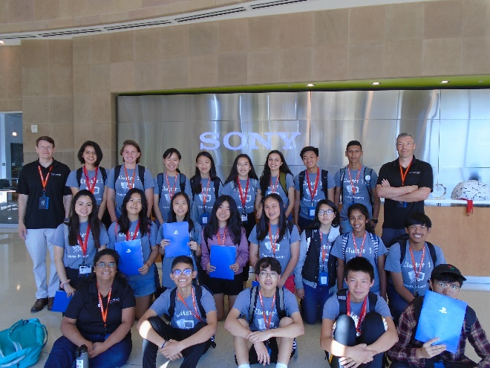
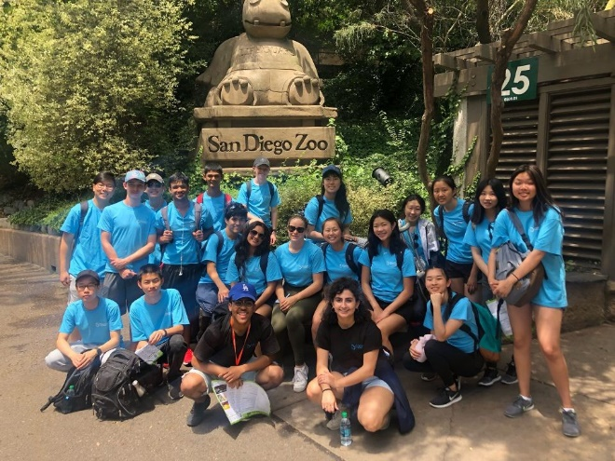
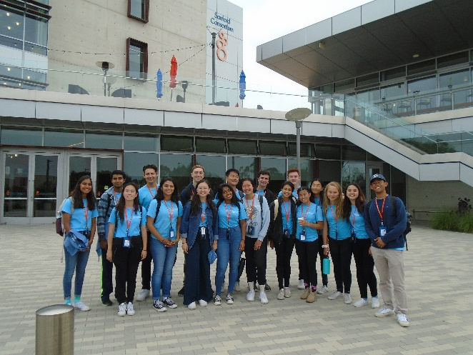
Information Session

Slide 2
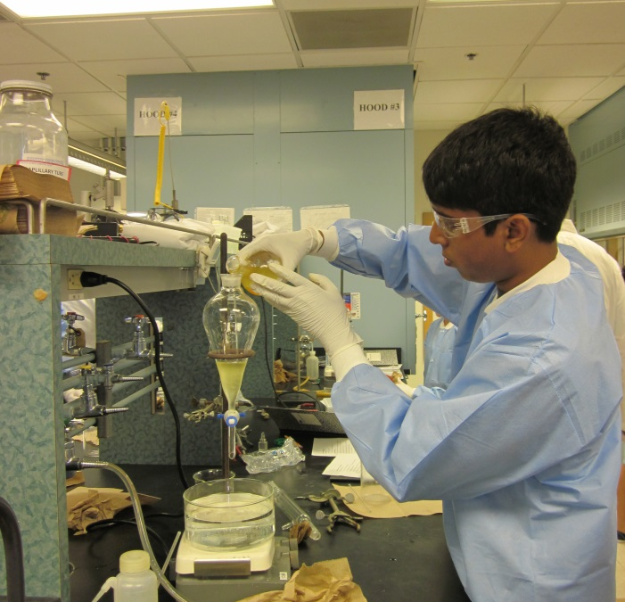
What is COSMOS?
Program Information
Four-week residential program
Advanced topics beyond the typical high school curriculum
Hands-on activities and work in university labs
Work side by side with university faculty and researchers
Work in teams on Final Project
Field trips to local industry/business
No grades or textbooks!
Notes:
Enrichment program, no academic credit

Slide 3
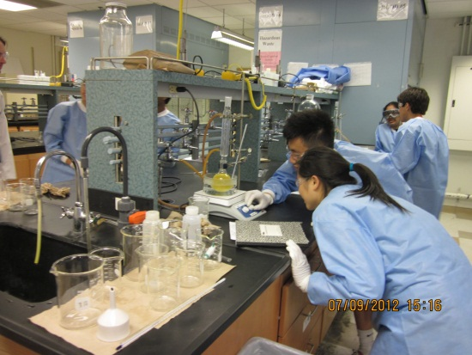
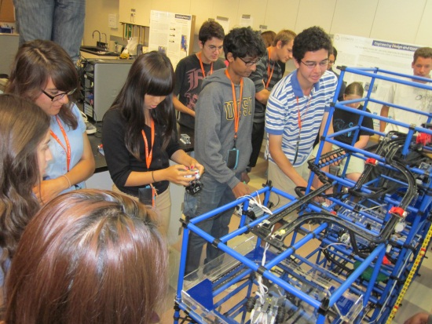
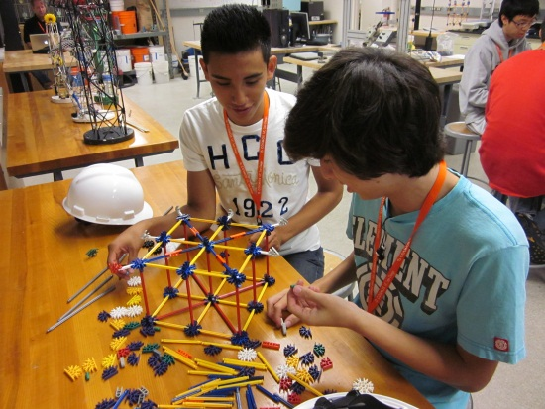
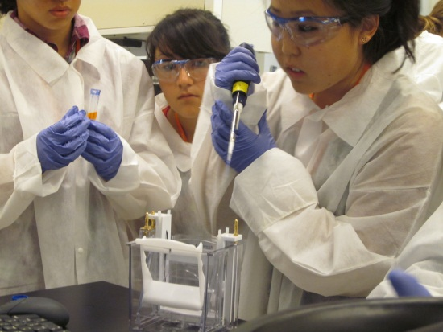
Goals of COSMOS
Motivate talented high school students
Excite students about math and science
Challenges beyond a regular classroom setting
Encourage students to continue in STEM (Science, Technology, Engineering & Math) majors in college
Enhance the academic experience by participating in team projects and presentations
Experience the college environment
Learn about the UC experience

Slide 4
Sample Cluster Topics
Biomedical Science (UCD)
Mathematics Modeling of Biological Systems (UCD)
Nanochemistry and Nanotechnology (UCSC)
Marine Mammals and Oceanography (UCSC)
Genes, Genomes and Biocontrol (UCI)
Engineering for Land, Air, and Space (UCI)
Engineering Design and Kinetic Sculptures (UCSD)
Tissue Engineering and Regenerative Medicine (UCSD)
Music and Technology (UCSD )
Robot Inventors (UCSD)
Notes:
Mention new cluster 10 - robotics

Slide 5
Four COSMOS Sites UC Davis

Slide 6
UC Davis

Slide 7
UC Irvine

Slide 8
UC San Diego

Slide 9
UC Santa Cruz

Slide 10
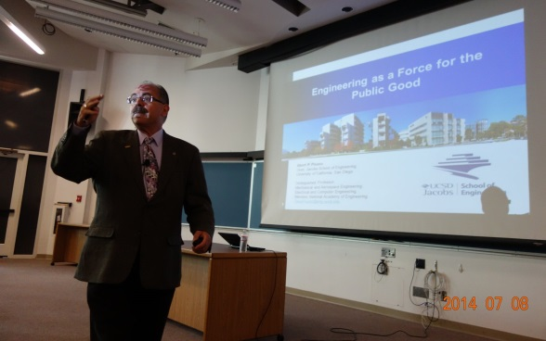
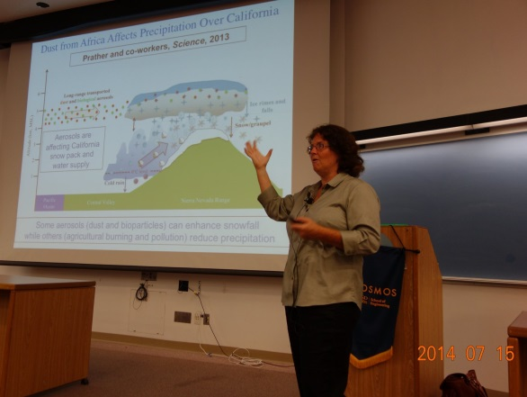
Discovery Lecture Series
Renowned scientists and faculty present on a wide range of research topics.
Focus on current research in the speaker's field
Designed to introduce students to a broad spectrum of subjects, expanding their learning outside of their cluster topics.
Presentations are held once a week

Slide 11
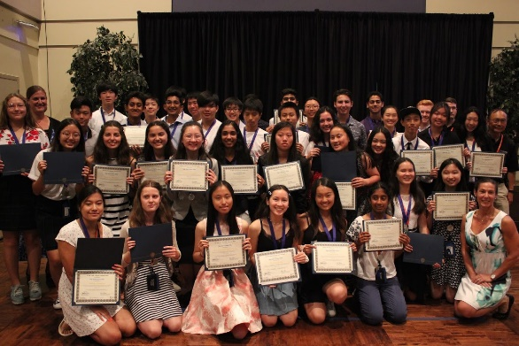
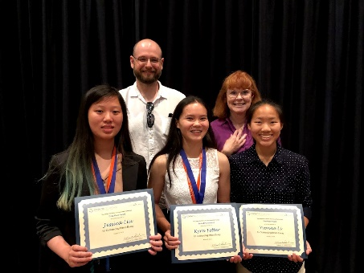
Scholarships and Opportunities
Gordon Leadership Awards
Awarded to one student team from each cluster for recognition of outstanding final project
Ethics Center Essay Contest Awards
Awarded to the top three Essays from all students throughout the COSMOS program.
Joseph Watson Leadership Awards
Awarded to one student per cluster that displays the most leadership qualities
Alumni Events
2019 UCSD COSMOS Gordon Leadership Awardees
2019 UCSD COSMOS Ethics Center Essay Contest Awardees

Slide 12
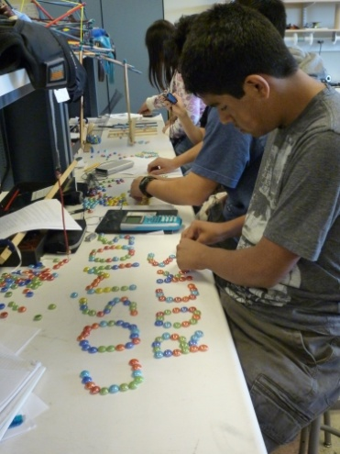
Who is Eligible?
Motivated & talented High School students
Competitive Admissions
Accepting rising 8th -12th graders
(Preference usually given to 9th-11th graders)
GPA typically 3.8 or above
Prerequisites for Clusters varies (please check specific campus website)
Notes:
Apply to one campus, choose top two clusters.

Slide 13
Cost & Financial Aid
$30 Application Fee (non-refundable)
$200 Program Acceptance Fee (non-refundable deposit)
Tuition:
CA Resident: $3928 ($6500 value)
Non-California Resident: $6500
Includes 4 weeks of residential housing
3 meals a day
Class materials
**Does not include transportation to campus
Financial Assistance Available for CA Students ONLY
Notes:
Tuition of $3928 does not include $200 deposit – total tuition is $4128

Slide 14
Financial Assistance
Financial assistance (full and partial) may be available for California residents based on verification of financial need.
Approximately 20% of students who attend the program receive either full or partial financial aid.
To confirm eligibility for financial aid, students must apply for it during the application process.
Total Financial Aid awarded in 2019 for all 4 COSMOS sites: $329,949
*Note: Financial aid is a scholarship and does not need to be repaid

Slide 15
CAMPUS | DATE | FAMILY WEEKENDS | FIELD TRIPS
UC Davis | Sunday, July 5th - Saturday, August 1st | 2nd and 3rd Weekend | River Cats Baseball Game Water Park SF Harbor Cruise
UC Irvine | Sunday, July 5th- Friday, July 31st | Every Weekend | Beach Trip CA Science Center Angels Baseball Game
UC San Diego | Sunday, July 5th - Saturday, August 1st | 2nd Weekend | San Diego Zoo Beach Trips Carnival
UC Santa Cruz | Sunday, July 5th - Saturday, August 1st | Every weekend | Santa Cruz Boardwalk Amusement Park Kayaking

Slide 16
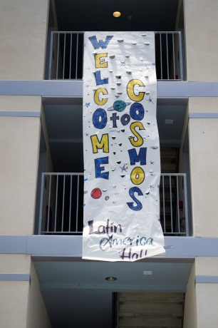
Application Process
Online application is available from January 6th – February 7st, 2020 5PM PST, continues unsupported until 11:59PM), at http://www.ucop.edu/cosmos
You may apply to only one campus, but you can and should, choose your top 2 clusters
Attending COSMOS provides you with extra consideration on your UC college application but does not guarantee admission to a UC

Slide 17
Links with videos:
https://www.uctv.tv/computer-science/search-details.aspx?showID=33917
http://jacobsschoolofengineering.blogspot.com/2018/08/cosmos-week-4-final-projects_31.html
http://jacobsschoolofengineering.blogspot.com/2018/08/cosmos-week-3-professors-perspectives.html

Slide 18
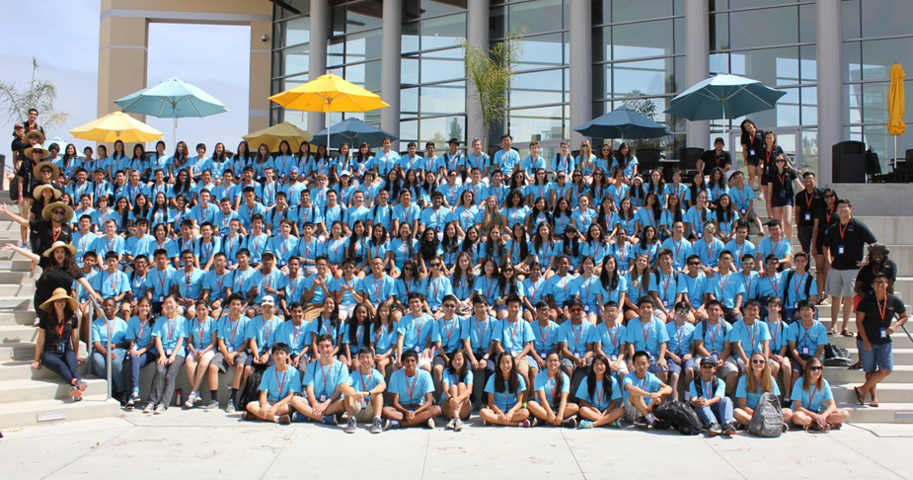
Come join us this summer!
cosmos@ucop.edu
http://cosmos-ucop.ucdavis.edu

