Slide 1
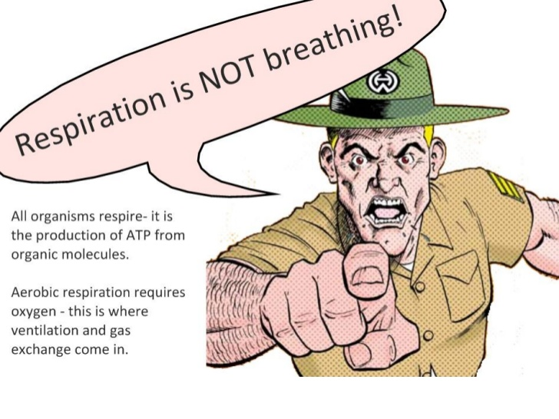
Topic 2.8 Cell Respiration
IB Biology

Slide 2
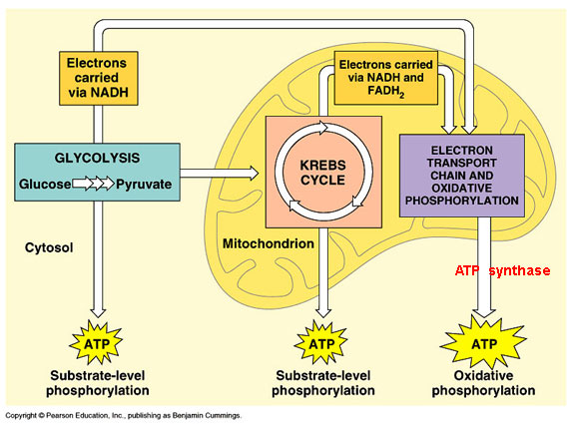
Cell Respiration
The most prevalent and efficient catabolic pathway for the production of ATP, in which oxygen is consumed as a reactant along with the organic fuel.

Slide 3
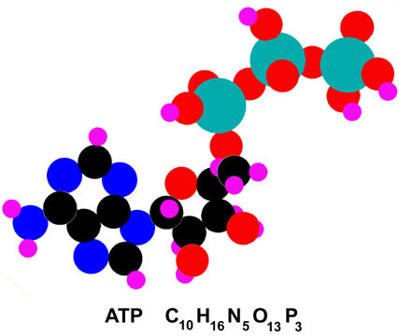
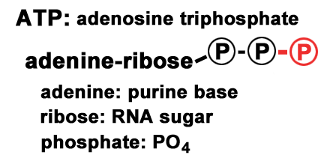
Adenosine Triphosphate (ATP)
An adenine containing nucleoside triphosphate that releases free energy when its phosphate bonds are hydrolyzed. This energy is used to drive endergonic reactions in cells.

Slide 4
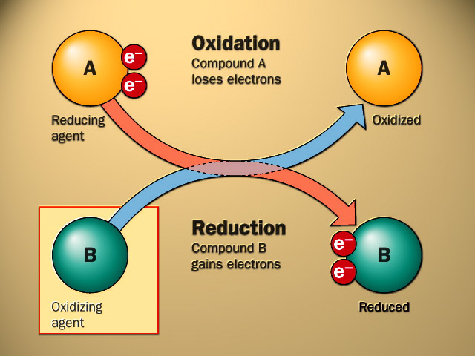
Oxidation
The loss of electrons from a substance involved in a redox reaction (transfer of electrons from one reactant to another).

Slide 5
Reduction
The addition of electrons to a substance involved in a redox reaction.

Slide 6
Glycolysis
The splitting of glucose into pyruvate. Glycolysis is the one metabolic pathway that occurs in all living cells, serving as the starting point for fermentation and aerobic respiration.

Slide 7
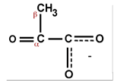
Pyruvate
Pyruvate is an oxidized three carbon sugar. During glycolysis, glucose is split into two three carbon sugars which are then oxidized to form two pyruvate molecules.

Slide 8
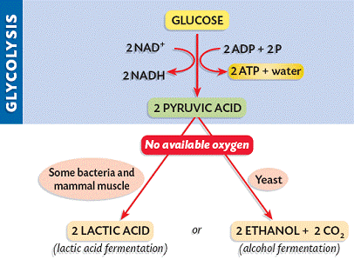
Anaerobic Respiration
A cellular process that lacks oxygen. It is a catabolic pathway that produces ATP and is also known as fermentation.

Slide 9
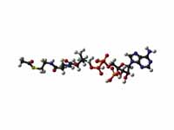
Acetyl CoA
Acetyl coenzyme A; the entry compound for the citric acid cycle in cellular respiration, formed from a fragment of pyruvate attached to a coenzyme.

Slide 10
Fermentation
A catabolic process that makes a limited amount of ATP from glucose without an electron transport chain and that produces a characteristic end product, such as ethyl alcohol or lactic acid.

Slide 11
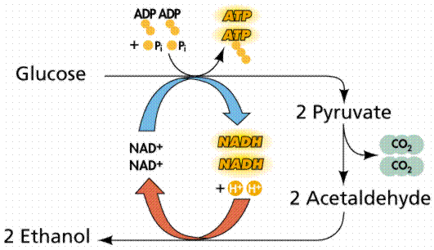
Alcohol Fermentation
The conversion of pyruvate to carbon dioxide and ethyl alcohol.

Slide 12
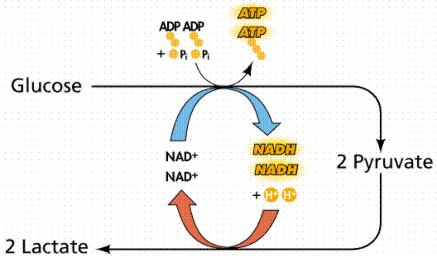
Lactic acid fermentation
The conversion of pyruvate to lactate with no release of carbon dioxide.

Slide 13
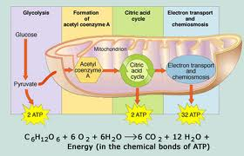
Aerobic respiration
A cellular process that requires oxygen. A catabolic pathway that completely breaks down glucose molecules to produce ATP.

Slide 14
Citric acid cycle
A chemical cycle involving eight steps that completes the metabolic breakdown of glucose molecules to carbon dioxide; occurs within the mitochondrion and is the second major stage in cellular respiration.
Commonly referred to as the Krebs cycle.

Slide 15
NAD⁺
Nicotinamide adenine dinucleotide, a coenzyme present in all cells that helps enzymes transfer electrons during the redox reactions of metabolism.

Slide 16
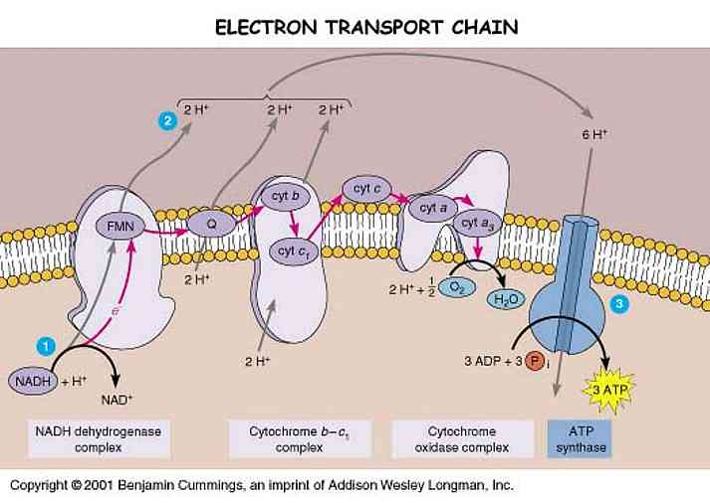
Oxidative phosphorylation
The production of ATP using energy derived from the redox reactions of an electron transport chain.

Slide 17
2.8 (U1) Cell respiration is the controlled release of energy from organic compounds to produce ATP.
Cell respiration involves the oxidation and reduction of biological molecules to produce ATP.
In cell respiration, when a substance is oxidized it loses electrons.
When a substances is reduced in cell respiration it gains electrons

Slide 19
Cell Respiration Pathways
The three main pathways or stages in cellular respiration are:
Glycolysis
Citric acid cycle
Oxidative phosphorylation

Slide 20
Biological Molecules and Cell Respiration
The biological molecules that can be consumed as fuel during cell respiration are carbohydrates, proteins and lipids.
Carbohydrates is the molecules most often used because it is the easiest of the three organic molecules to metabolize.

Slide 21
Slow Oxidation
Cell respiration is often referred to as slow oxidation due to the fact that the organic molecule used as fuel for the metabolic pathway is slowly broken apart.
In slow oxidation, molecules are acted on by a series of enzymes and there are sequential reactions which break bonds one at a time to control the release of energy.

Slide 22
2.8 (U2) ATP from cell respiration is immediately available as a source of energy in the cell.
The three main types of cell activities that require
energy in the form of ATP are:
The synthesis of large molecules such as DNA, RNA and proteins.
Active transport: the pumping of molecules or ions across the cell membrane.
The movement of materials such as chromosomes and vesicles inside the cell, or the contraction of protein fibres in muscle cells.

Slide 23
Advantages of using ATP
ATP is produced in cell respiration by attaching a phosphate molecule to ADP.
Once ATP is made the energy is immediately available by splitting ATP into ADP and phosphate.
Both products can be used again in cell respiration to produce more ATP.
Energy is lost as heat and this is why we need a continual supply of ATP.

Slide 24
2.8 (U3) Anaerobic cell respiration gives a small yield of ATP from glucose.
During anaerobic cell respiration, glucose is broken down without the use of oxygen and the yield of ATP is relatively small. This can be useful in the following situations:
When a short, rapid burst of ATP is required.
When respiring cells run out of oxygen
When cells are in an environment that is deficient in oxygen (i.e., waterlogged soils).

Slide 25
Anaerobic Respiration
Humans primarily respire aerobically but will revert to anaerobic when required. Organisms that primarily respire anaerobically are referred to as anaerobes and this process is also known as fermentation.
The process are different in humans and yeast. Although both begin with a glucose molecule, the products are different.
Also, the products from both pathways are toxic in large amounts so they must be removed from the cells.

Slide 26
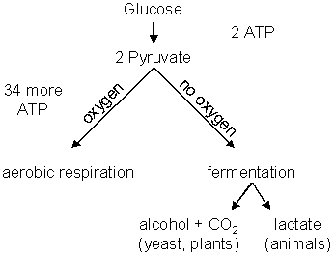
Anaerobic Respiration
There are two main anaerobic pathways, lactic acid fermentation (animals) and alcoholic fermentation (yeast & plants).

Slide 27
Alcoholic Fermentation

Slide 28
Lactic Acid Fermentation
Organisms that mainly use aerobic respiration can occasionally find themselves in a situation where there is not enough oxygen to continue on the aerobic pathway. This often occurs if someone is pushing their body beyond their normal exercise routine.
In this situation the respiration pathway converts to anaerobic. Due to the lack of oxygen, after glycolysis is completed the pyruvate molecules are converted into lactic acid ( C₃H₆O₃ ) molecules.

Slide 29
Lactic Acid Fermentation

Slide 30
2.8 (U4) Aerobic cell respiration requires oxygen and gives a large yield of ATP from glucose.
If oxygen is available in cells then the glucose molecules can be further broken down in aerobic respiration. It involves two more pathways (Krebs cycle and electron transport chain) and yields a much larger amount of ATP.
Anaerobic respiration can only yield 2 ATP but aerobic respiration can yield more than 30 ATP molecules from every glucose molecule.

Slide 31
End Products of Aerobic Respiration
Unlike anaerobic respiration, aerobic respiration completely breaks down or oxidizes glucose molecules and the end products are ATP, carbon dioxide and water.
Aerobic respiration can produce about 34-36 molecules of ATP for every one glucose molecule.

